Slide 1


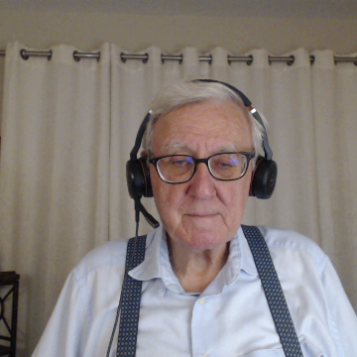
This Page is Under Construction
We are currently working on this Micro-Learning Module and plan to publish an update shortly.
Feel free to send us suggestions or draft content using the link below.
Note that PERA MLMs may be downloaded for free according to the Creative Commons copyright.
  Please click here to provide feedback on this MLM.
Notes:
The requested MLM is not currently available, but we are working on it.
If you find this PERA website useful, please use the feedback link to send us your comments and content suggestions.

